Slide 1
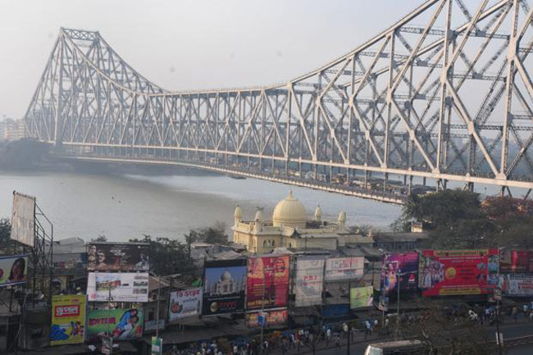
A taste of West Bengal

Slide 2
Chef Lee Business Entrepreneurship and Menu Management
CRN – 81136-201503
Tuesday 8AM – 10AM Class
Students:
Graeme Foley – 100952145
Jaeyoung Park – 100964497
Ricky Jay Danao – 100960576
Ravi Shankar Shukla - 101028218

Slide 3
Table of Contents
Executive Summary - - - - - - - - - - - - - - - - - - - - - 4
Menu - - - - - - - - - - - - - - - - - - - - - - - - - - - - - - - 6
Rental Requirements - - - - - - - - - - - - - - - - - - - - 7
Standardized Recipes - - - - - - - - - - - - - - - - - - - - 8
Recipe Costing - - - - - - - - - - - - - - - - - - - - - - - - - 15
Item Consolidation - - - - - - - - - - - - - - - - - - - - - 22
Action Plan - - - - - - - - - - - - - - - - - - - - - - - - - - - 24
Event Plan - - - - - - - - - - - - - - - - - - - - - - - - - - - - 26
Plate Plans - - - - - - - - - - - - - - - - - - - - - - - - - - - - 27
Dining Room Setup - - - - - - - - - - - - - - - - - - - - - 30
Income Statement - - - - - - - - - - - - - - - - - - - - - - - 32
Equipment List - - - - - - - - - - - - - - - - - - - - - - - - - 33

Slide 4
Executive Summary

Slide 5
Executive Summary

Slide 7
Rental Requirements

Slide 8
Standardized Recipes

Slide 9
Standardized Recipes (cont.)

Slide 10
Standardized Recipes (cont.)

Slide 11
Standardized Recipes (cont.)

Slide 12
Standardized Recipes (cont.)

Slide 13
Standardized Recipes (cont.)

Slide 14
Standardized Recipes (cont.)

Slide 15
Costing...

Slide 16
Costing (cont.)...

Slide 17
Costing (cont.)...

Slide 18
Costing (cont.)...

Slide 19
Costing (cont.)...

Slide 20
Costing (cont.)...

Slide 21
Costing (cont.)...

Slide 22
Item Consolidation

Slide 23
Item Consolidation (cont.)

Slide 27
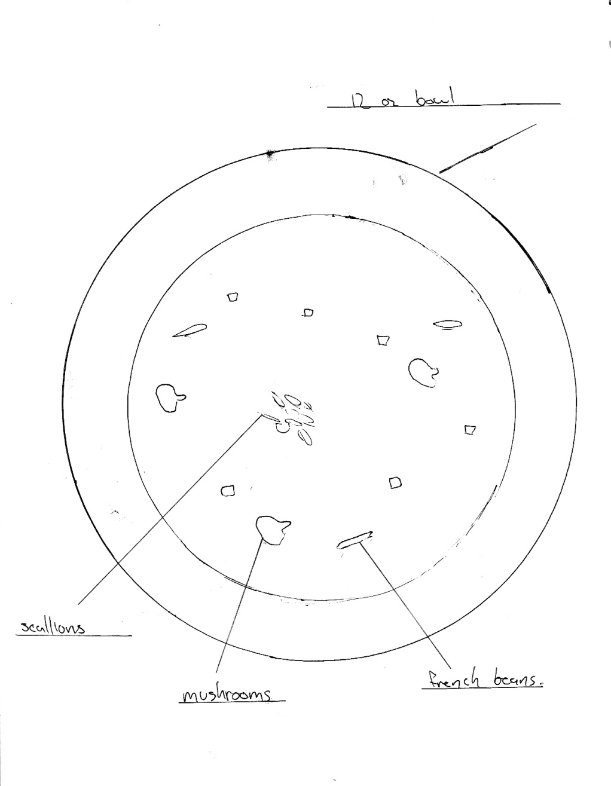
Soup and Salad Plate Plans

Slide 28
Aloo Posto and Rohu Dum Pukht Plate Plans

Slide 29
Biryani and Rasagulla Plate Plans

Slide 30
Dining Room

Slide 31
Table Setting

Slide 32
Income Statement/Schedule

Slide 33
Equipment List

